Slide 1
​​
UNIT-IV Hashing :
Hash Table- Concepts-hash table, hash function, basic operations, bucket, collision, probe, synonym,
overflow, open hashing, closed hashing, perfect hash function, load density, full table, load factor,
rehashing, issues in hashing, hash functions- properties of good hash function, division,
multiplication, extraction, mid-square, folding and universal, Collision resolution strategies- open
addressing and chaining, Hash table overflow- open addressing and chaining, extendible hashing,
closed addressing and separate chaining.
Skip List- representation, searching and operations- insertion, removal

Slide 2
Hash Tables
Constant time accesses!
A hash table is an array of some fixed size, usually a prime number.
General idea:
hash table
0
 | …
hash function:
h(K)
key space (e.g., integers, strings)
TableSize –1
2
Notes:
2

Slide 3
Example
0
1 | 41
2
3
4 | 94
5
6
7 | 7
8 | 18
9
key space = integers
TableSize = 10
h(K) = K mod 10
Insert: 7, 18, 41, 94
3
Notes:
3

Slide 4
Another Example
key space = integers
TableSize = 6
h(K) = K mod 6
Insert: 7, 18, 41, 34
0 | 18
1 | 7
2
3
4 | 34
5 | 41
4
Notes:
4
7 (6*1 = 6)->1, 18-> 0, 41(6*6=36) -> 5, 34 (5*6)=30-> 4
Q: Why don’t we just create a table of size 100, or 40 and just map them directly to location?
A: Assumption is key space is much larger than the number of values we have to insert. (Ex. Using social security # as the key to put students in this class in a hash table. Table of size 999,999,999??)
Q: How long does that take to insert? O(1)
Q: How do we find them?
Q: How long does that take?
Q: What if we insert 12? (It wants to go in location 0 – CONFLICT)

Slide 5
Hash Functions
simple/fast to compute,
Avoid collisions
have keys distributed evenly among cells.
Perfect Hash function:
5
Notes:
5

Slide 6
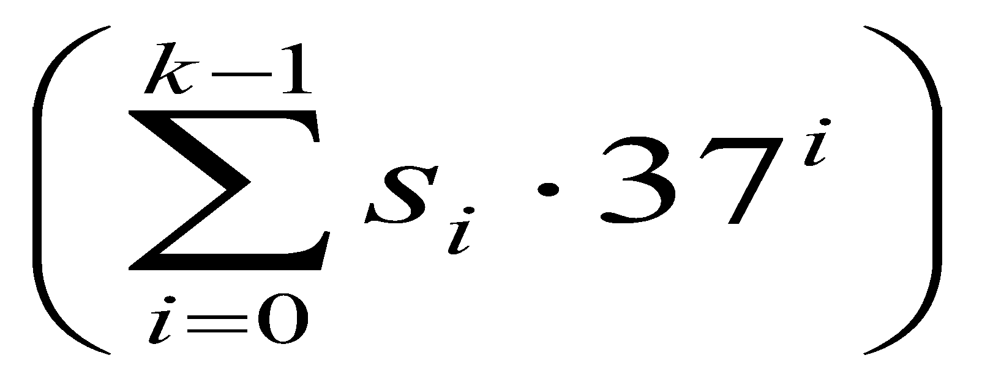
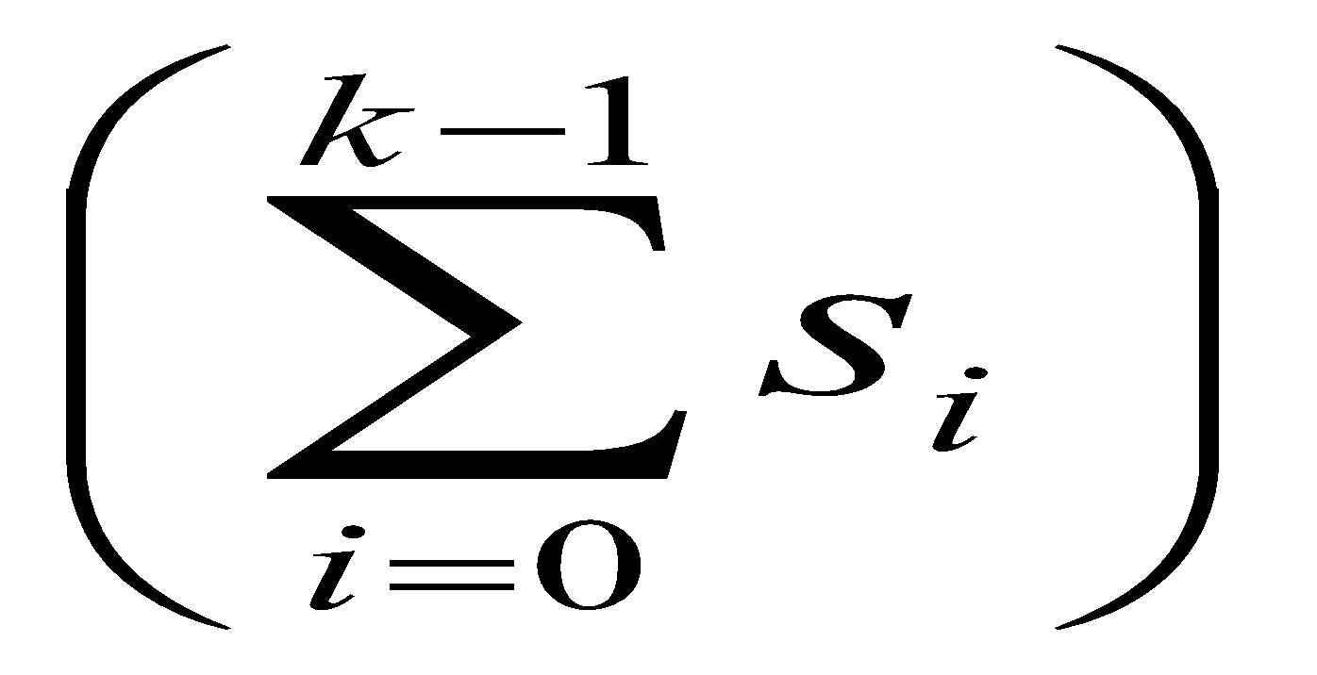
Sample Hash Functions:
key space = strings
s = s₀ s₁ s₂ … s _{k-1}
h(s) = s₀ mod TableSize
h(s) = mod TableSize
h(s) = mod TableSize
6
Notes:
6
3) Takes the position of each character into account, like with a positional number system.
[s0 + s1*37 + s2*37^2+s3*37^3]

Slide 7
Collision Resolution
Collision: when two keys map to the same location in the hash table.
Two ways to resolve collisions:
Separate Chaining
Open Addressing (linear probing, quadratic probing, double hashing)
7

Slide 8
Separate Chaining
Insert:
10
22
107
12
42
0 | 10
1
2 | 22/12/42
3
4
5
6
7 | 107
8
9
Separate chaining: All keys that map to the same hash value are kept in a list (or “bucket”).
8
Notes:
8

Slide 9

Analysis of find
Defn: The load factor, λ, of a hash table is the ratio:
← no. of elements
← table size
For separate chaining, λ = average # of elements in a bucket
Unsuccessful find:
Successful find:
9
Notes:
9

Slide 10
How big should the hash table be?
For Separate Chaining:
10

Slide 11
tableSize: Why Prime?
Suppose
data stored in hash table: 7160, 493, 60, 55, 321, 900, 810
tableSize = 10
data hashes to 0, 3, 0, 5, 1, 0, 0
tableSize = 11
data hashes to 10, 9, 5, 0, 2, 9, 7
Real-life data tends to have a pattern
Being a multiple of 11 is usually not the pattern ☺
11

Slide 12
Open Addressing
Insert:
38
19
8
109
10
0 | 8
1 | 109
2 | 10
3
4
5
6
7
8 | 38
9 | 19
Linear Probing: after checking spot h(k), try spot h(k)+1, if that is full, try h(k)+2, then h(k)+3, etc.
12
Notes:
12

Slide 13
Terminology Alert!
“Open Hashing”
equals
“Separate Chaining”
“Closed Hashing”
equals
“Open Addressing”
13

Slide 14
Linear Probing
f(i) = i
Probe sequence:
0th probe = h(k) mod TableSize
1th probe = (h(k) + 1) mod TableSize
2th probe = (h(k) + 2) mod TableSize
. . .
i^{th} probe = (h(k) + i) mod TableSize
14
Notes:
14
Add a function of I to the original hash value to resolve the collision.
Primary clustering – we notice this effect in the previous slide.
Any key that hashes into the cluster 1) will require several attempts to resolve collision and 2) will then add to the cluster. (Both 1 and 2 are bad)

Slide 15
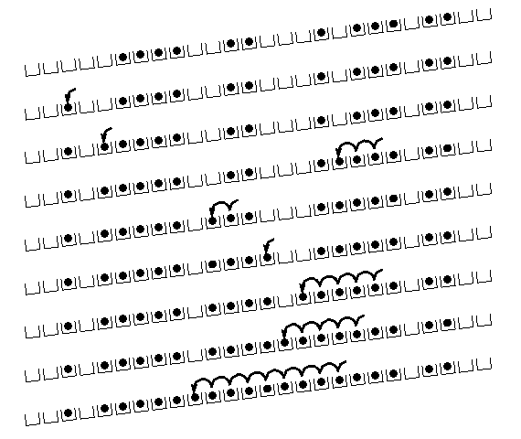
Linear Probing – Clustering
no collision
collision in small cluster
no collision
collision in large cluster
[R. Sedgewick]
15
Notes:
15
You can see that this works pretty well for an empty table and gets worse as the table fills up.
There’s another problem here. If a bunch of elements hash to the same spot, they mess each other up.
But, worse, if a bunch of elements hash to the same area of the table, they mess each other up! (Even though the hash function isn’t producing lots of collisions!)
This phenomenon is called primary clustering.

Slide 16
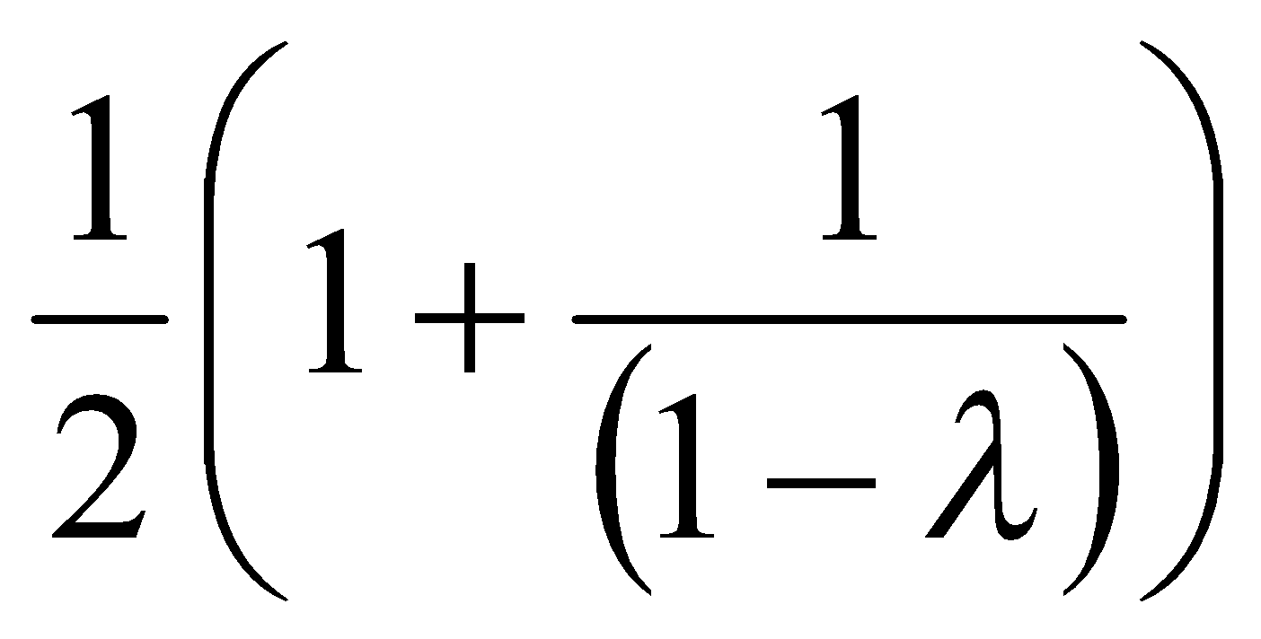
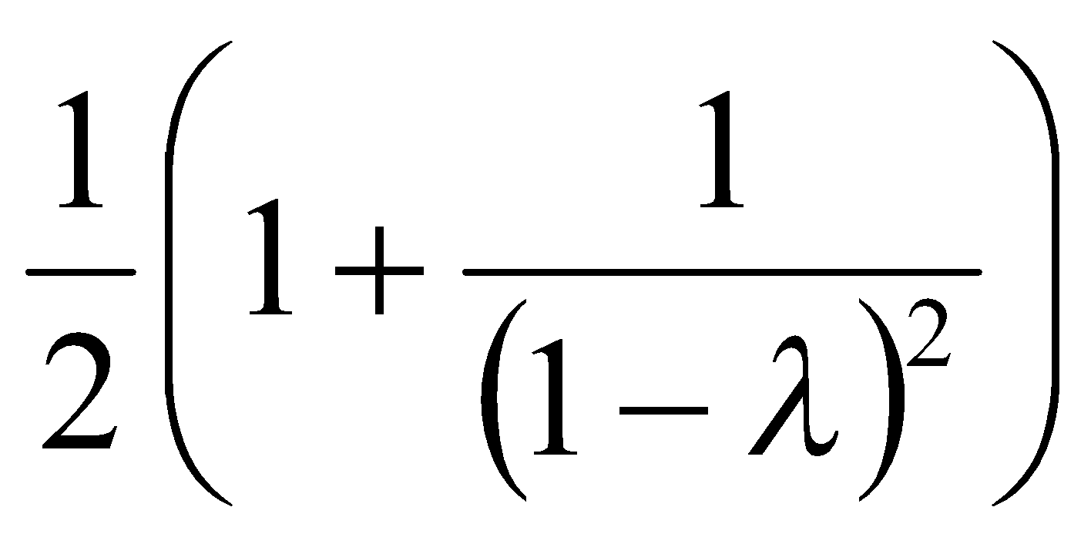
Load Factor in Linear Probing
For any λ < 1, linear probing will find an empty slot
Expected # of probes (for large table sizes)
successful search:
unsuccessful search:
Linear probing suffers from primary clustering
Performance quickly degrades for λ > 1/2
16
Notes:
16
There’s some really nasty math that shows that (because of things like primary clustering), each successful search w/linear probing costs…
That’s 2.5 probes per unsuccessful search for lambda = 0.5.
50.5 comparisons for lambda = 0.9
We don’t want to let lambda get above 1/2 for linear probing.

Slide 17
Quadratic Probing
Less likely to encounter Primary Clustering
f(i) = i²
Probe sequence:
0th probe = h(k) mod TableSize
1th probe = (h(k) + 1) mod TableSize
2th probe = (h(k) + 4) mod TableSize
3th probe = (h(k) + 9) mod TableSize
. . .
i^{th} probe = (h(k) + i²) mod TableSize
17
Notes:
17
Add a function of I to the original hash value to resolve the collision.
Less likely to encounter primary clustering, but could run into secondary clustering.
Although keys that hash to the same initial location will still use the same sequence of probes (and conflict with each other).
How big to make hash table? Lambda = ½, (hash table is twice as big as the number of elements expected.)
Note: (i +1)² – i² = 2i + 1 Thus, to get to the NEXT step, you can add 2* current value of i plus one.

Slide 18
Quadratic Probing
0
1
2
3
4
5
6
7
8
9
Insert:
89
18
49
58
79
18

Slide 19
Quadratic Probing Example
insert(76)
76%7 = 6
insert(40)
40%7 = 5
insert(48)
48%7 = 6
insert(5)
5%7 = 5
insert(55)
55%7 = 6
0
1
insert(47)
47%7 = 5
But…
2
3
4
5
6
76
19
Notes:
19
And, it works reasonably well.
Here it does fine until the table is more than half full.
Let’s take a closer look at what happens when the table is half full.

Slide 20
Quadratic Probing: Properties
For any λ < ½, quadratic probing will find an empty slot; for bigger λ, quadratic probing may find a slot
Quadratic probing does not suffer from primary clustering: keys hashing to the same area are not bad
But what about keys that hash to the same spot?
Secondary Clustering!
20
Notes:
20
At lambda = 1/2 about 1.5 probes per successful search
That’s actually pretty close to perfect… but there are two problems.
First, we might fail if the load factor is above 1/2.
Second, quadratic probing still suffers from secondary clustering. That’s where multiple keys hashed to the same spot all follow the same probe sequence.
How can we solve that?

Slide 21
Double Hashing
f(i) = i * g(k) where g is a second hash function
Probe sequence:
0th probe = h(k) mod TableSize
1th probe = (h(k) + g(k)) mod TableSize
2th probe = (h(k) + 2*g(k)) mod TableSize
3th probe = (h(k) + 3*g(k)) mod TableSize
. . .
i^{th} probe = (h(k) + i*g(k)) mod TableSize
21
Notes:
21
So the probe sequence is a function of the key in two different ways – for the original starting location (h(k) AND for the amount of offset you move out each time you have a collision (g(k)). (as opposed to both linear probing and quadratic probing where the offset is independent of the key)
** In choosing g care must be taken so that it never evaluates to 0.
A good choice for g is to choose a prime R < TableSIze and let g(k) = R – (k mod R).
Double Hashing is Safe for λ < 1

Slide 22
Double Hashing Example
h(k) = k mod 7 and g(k) = 5 – (k mod 5)
76
93
40
47
10
55
0
0
0
0
0
0
1
1
1
1
47
1
47
1
47
2
2
93
2
93
2
93
2
93
2
93
3
3
3
3
3
10
3
10
4
4
4
4
4
4
55
5
5
5
40
5
40
5
40
5
40
6
76
6
76
6
76
6
76
6
76
6
76
Probes 1 1 1 2 1 2
22

Slide 23
Resolving Collisions with Double Hashing
0
1
2
3
4
5
6
7
8
9
Hash Functions:
H(K) = K mod M
H₂(K) = 1 + ((K/M) mod (M-1))
M =
Insert these values into the hash table in this order. Resolve any collisions with double hashing:
13
28
33
147
43
23
Notes:
23

Slide 24
Dynamic Hashing
For good performance , it is necessary to increase size of hash table; whenever its loading density exceeds a pre specified threshold
EX: if there are b buckets in hash table and using a division hash function then D=b.
When an insert causes the loading density to exceed the prespecified threshold. We use array doubling to increase the number of buckets to 2b+1. This change in divisor require to rebuild hash table
Dynamic Hashing : Also known as extendible hashing , aims to reduce the rebuild time by ensuring that each rebuild changes the home bucket for the entries in only 1 bucket.
Objective of dynamic hashing is to provide acceptable hash table performance on a per operation basis.

Slide 25
Types of Dynamic Hashing
Using Directory
With out directory
Both forms, hash function h used to map key into non negative integers.
Ex: h(k) transforms keys into 6 bit non negative integers.
Let keys with 2 character each and h transfroms letters such as A B and C into bit sequence like 100, 101 and 110
Digits 0 to 7 are transformed into their 3 bit representation
K | h(K)
A0 | 100 000
A1 | 100 001
B0 | 101 000
B1 | 101 001
C1 | 110 001
C2 | 110 010
C3 | 110 011
C5 | 110 101

Slide 26
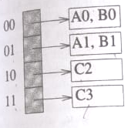
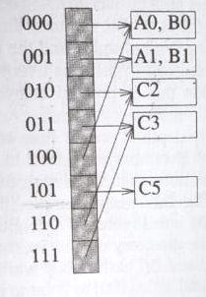
Dynamic Hash Table with directories
The Number of bits of h(k) used to index the directory is called the directory depth
Depth = 2
Depth = 3

Slide 27
Hashing Summary
Hashing is one of the most important data structures.
Hashing has many applications where operations are limited to find, insert, and delete.
Dynamic hash tables have good amortized complexity.
27

